Slide 1
Synchrophasors:
Improving Reliability & Situational Awareness
October 12, 2011
Research & Technology Management
Clifton Black

Slide 2
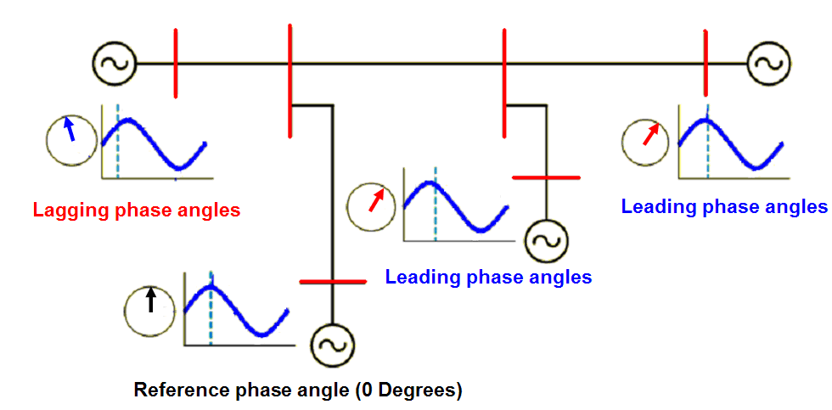
Outline
What are PMUs?
PMUs - Concept & Operation
The Need for PMUs
Synchrophasor Applications
Southern Company PMU Activities
PMUs Activities in North America

Slide 3
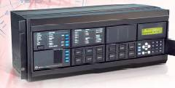
What are PMUs?
PMUs provide high resolution synchronized
measurements of phasor voltages and currents
They are placed at key locations like power plants and major substations

Slide 4
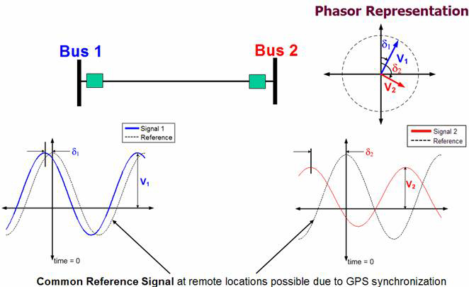
Concept & Operation
Phasors
Phase Angles have a reference

Slide 5
Concept & Operation contd.
ATTRIBUTE | SCADA | PHASOR
Measurement | Analog | Digital
Resolution | 2-4 sam./sec. | 60 sam./sec.
Observability | Steady State | Transient
Phase angle | No | Yes
Measured | |V|, MW, MVAR | |V|,δ, MW, MVAR, |δ₂ – δ₁|
Synchronized | No | Yes

Slide 6
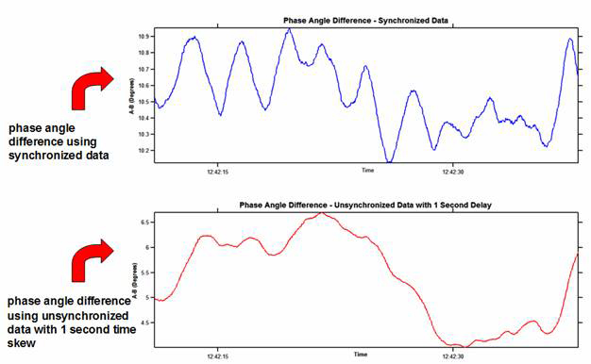
Concept & Operation contd.
Time Synchronization
Time-skewed measurements introduce errors
Average Angle Difference ~ 10º
Average Angle Difference ~ 5º

Slide 7

The Need for PMUs
Investigation of August 14, 2003 Blackout revealed
Lack of Wide Area Visibility
Lack of Time Synchronized Data
Inability to Monitor System Dynamic Behavior in Real-time

Slide 8
The Need for PMUs Contd.
Wide-Area and Sub-SCADA Visibility
Time Synchronization allows Dynamics not visible in SCADA
Angular or Dynamic warning signs are usually present before major events
  Recent Major Blackouts
August 14th Angular Separation
12 Degrees
25 Degrees
45 Degrees
115 Degrees

Slide 9
The Need for PMUs Contd.
Post Disturbance Analysis of August 10, 1996 Blackout
PMUs allow us to‘see’ the dynamic behavior of the grid which models sometimes incorrectly predict.

Slide 10

Synchrophasor Applications
Synchrophasors facilitates improvement in Situational Awareness, Modeling Accuracy & System Reliability
Real-time Applications
Off-line Applications
Wide-Area Visualization & Monitoring
Frequency Stability Monitoring & Trending
Voltage Monitoring & Trending
State Estimation
Oscillation Monitoring
Resource Integration
Equipment Failure Detection
Power System Model Verification
Event Analysis & Reconstruction
Equipment Failure Detection
Fault Location
Baselining Power System Performance
Load Characterization

Slide 11
Synchrophasor Applications contd.
A Few of the Current Implementations
CAISO, BPA, AEP incorporating phasor data into State Estimation tools
Entergy used phasor data to manage system separation, islanding and restoration during Gustav (2008)
CAISO & ERCOT will be using phasor data to monitor and integrate intermittent generation
SCE using phasor data for automated control of SVC for reactive power support
Phasor systems being used for WAMS in North America, Quebec, Brazil, China and Europe

Slide 12
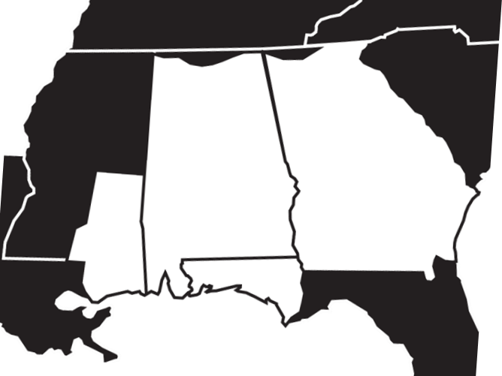

Southern Company PMU Locations
Plant Bowen
South Hall
Plant Miller
Norcross
West McIntosh
Plant Farley
Plant Hatch
Thallman
Plant Barry
Plant Daniel

Slide 13
Southern Company’s PMU Architecture
Local PDC and Historian facilitates flexibility, security and data accessibility
_{BOWEN}
_{NORCROSS}
_{SOUTH HALL}
_{MILLER}
V_{e}θ_{e}
V_{g}θ_{g}
V_{d}θ_{d}
V_{f}θ_{f}
_{BARRY}
_{WEST MCINTOSH}
V_{c}θ_{c}
Phasor Data Concentrator (PDC) - Local
V_{h}θ_{h}
_{DANIEL}
_{HATCH}
Local Applications
Local Historian
V_{i}θ_{i}
V_{b}θ_{b}
_{FARLEY}
V_{j}θ_{j}
V_{a}θ_{a}
_{THALMANN}
Regional PDC

Slide 14
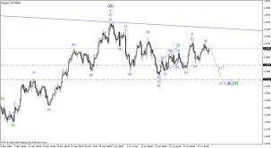
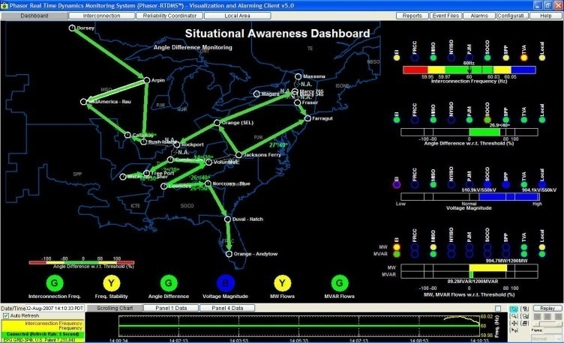
Current Use of PMU data
Post Event Analysis & Model Validation – Transmission Planning
Wide Area Monitoring and Situational Awareness – Research

Slide 15
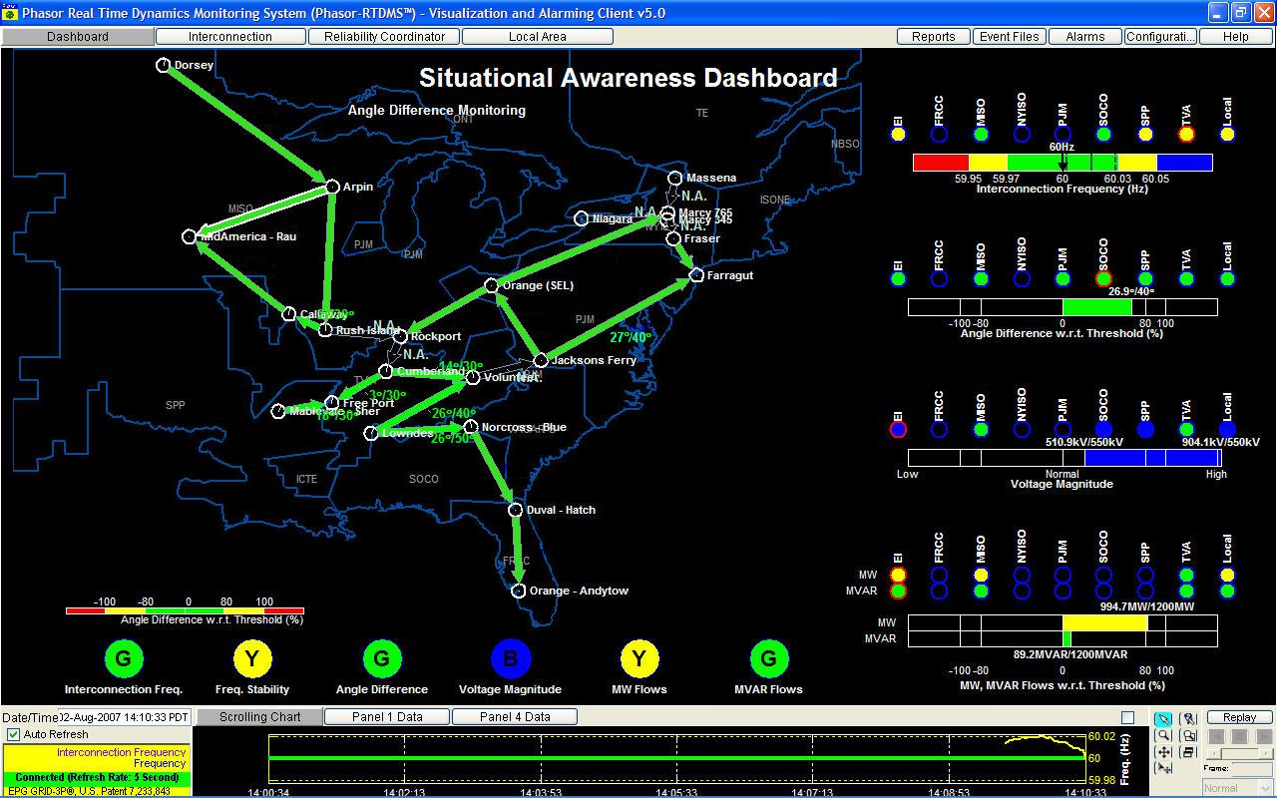
Example of Wide-area Monitoring Tool
Real-time Dynamics Monitoring System (RTDMS)
GAUGES: Quantify the worst performing metric
LOCATION INDICATORS: Provide information
about specific locations w.r.t. the metric
TRAFFIC LIGHTS: Provide status of specific metrics
across all locations

Slide 16
Synchrophasor Research
Project with PNNL: Multi-Variable Statistical Analysis –
Identifying atypical events and precursors to proactively manage the grid
AREVA PMU Project: Impact of PMU data on State Estimation & State Estimation Metrics
NEETRAC Project: Next Generation PMUs/Evaluation
CEATI: Prediction of Power System Instability based on PMU data: Utilizing the Region of Stability Existence (ROSE) Approach.
Provide Operators with fast and accurate solutions in order to predict system instability and prevent wide-spread blackouts using PMU data.

Slide 17
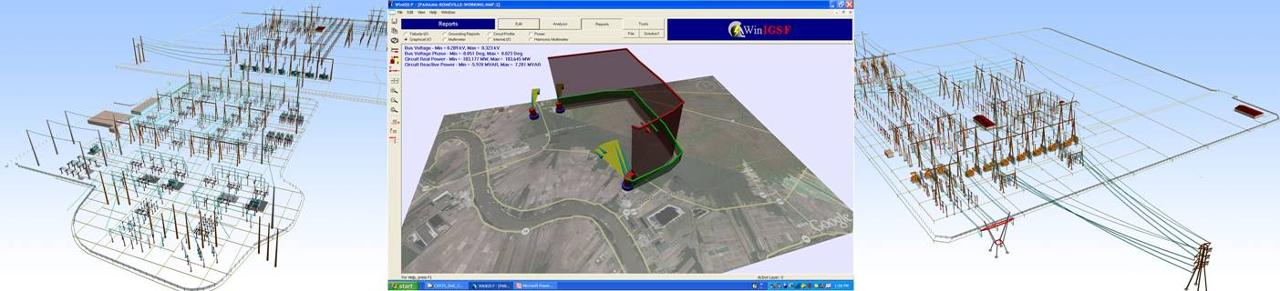
Demonstration Project w/ GaTech
Distributed State Estimator, Generator Parameter Estimation and Stability Monitoring
  Distributed State Estimator for two substation subsystem
  Develop Generator parameter Estimator for a generating unit
  Develop transient stability monitoring system for generating plant

Slide 18
PMUs in North America

Slide 19
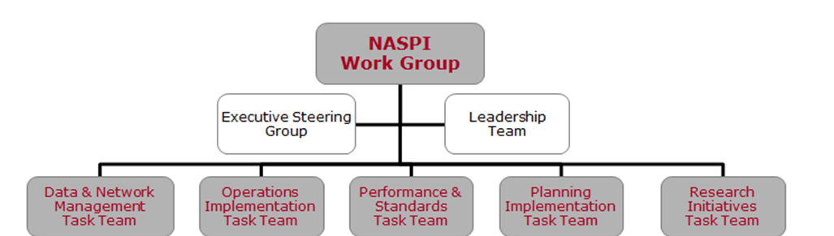
PMU Activities in North America
North America
  North American Synchrophasor Initiative (NASPI) www.naspi.org
  SPDC evolving to regional PDCs
  PhasorGateway – Communications & Traffic Management Infrastructure
  Tremendous boost from ARRA funding
NASPI Structure

Slide 20
Where Are We Going?
Recommended Industry Deployment Roadmap
Role of PMUs
1. Angle/Freq. Monitoring
Necessary
12. Post-mortem Analysis
Additional Benefits
2. Voltage Stability Monitoring
More Investigation
3. Thermal Overload Monitoring
5. State Estimation (Improv.)
10. Congestion management
7. State Measurement (linear)
13. Model Benchmarking;
Parameter Estimation
14. Model Benchmarking; Parameter Estimation
4. Real-Time Control
16. DG/IPP Applications
15. Planned Power System
Separation
9. Adaptive Protection
11. Power system restoration
6. State Estimation
(Boundary Conditions)
8. WA Stabilization (WA-PSS)
1-3 Years
3-5 Years
> 5 Years
CIEE Report

Slide 21
SGIG PMU Projects
Project Lead | # of PMU (Stations) | Key Applications
ISO New England | 30 | Real-time situational awareness, Congestion management
New York ISO | 39 | Real-time situational awareness, Voltage monitoring and control Communications system
PJM Interconnection | 80+ | Real-time situational awareness including trending, Oscillation detection, Islanding detection
Midwest ISO | 150+ | Real-time situational awareness, Voltage monitoring Renewable integration, Congestion management, State estimation, Oscillation monitoring, EMS alarms
Western Electric Coordinating Council | 250+ | Wide-area real-time situational awareness and visualization, Alarming, Oscillation monitoring, Voltage monitoring, Renewable integration, Congestion management, Automatic controls, Power system performance analysis, System-wide model validation, Post-event analysis
Entergy Services | 18 | Increase grid monitoring, train and educate grid operators and engineers on phasor technology
Duke Energy | 102 | Wide-area real-time situational awareness, enhanced state estimator and Renewables integration

Slide 22
What Do We Need Now?
Demarcation where currents tools end and PMU tools begin
Development and Deployment of Applications
Practical tools for Operators
Actionable Information
‘Killer Apps’
Knowledge/Experience from SGIG implementations
More Research

Slide 23

Questions

